Slide 1
Content
The main integral theorem and its applications
Magnetic circuits: overview
Use of the main integral theorem in magnetic circuits
Magnetomotive force (MMF) of a coil
Flux continuity and Kirchhoff’s first law for magnetic fluxes
Magnetic reluctance and redistribution of magnetic flux
Main steps in designing magnetic circuits
Coil permeance in a magnetic circuit
Self-induction effect and coil self-inductance in a magnetic circuit
Variable coil permeance and self-inductance
Inductively connected coils, mutual induction effect, and mutual inductance
Experimental determination of self-inductances

Slide 2
The main integral theorem and its applications
Circulation of
the magnetising force
Flux of the current density through S.
For these integrals, we have to agree on the integration direction for the contour integral and the orientation of normal vector n for the surface integral. The contour integration is positive (see Appendix 3 in Lecture 2) if the contour L is at the left when we move along it. In the theorem, the contour integral is assumed to be positive. To provide the physically correct sign, the vector n normal to the surface S must be orientated according to the right-hand screw driver rule if we rotate it in the positive integration direction.

Slide 3
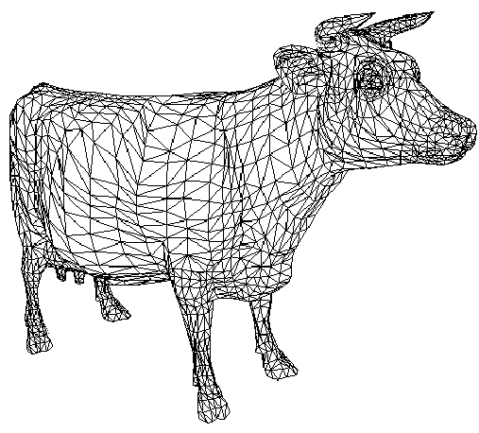
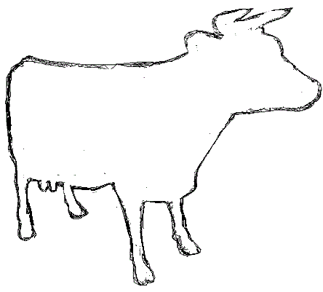
Surface integral
1) A surface is divided into small pieces Δs_{i} (of any shape), where i is the serial number of each piece.
2) For each piece Δs_{i} , we have to find the scalar product of a given vector field A (which can depend on coordinates) and the unit normal vector n both calculated in some point on this piece of surface, except its boundary. The normal vector n can be directed inside the volume or outside. The orientation of n is conventional and it is specified for each particular task.
3) The surface integral is defined as the following sum over all pieces with Δs_{i}→0:

Slide 4
Contour integral
1) A curve (2D or 3D) is divided into small pieces Δl_{i}, where i is the serial number of each piece.
2) For each piece Δl_{i} , we have to find the scalar product of the given vector field A (which can depend on coordinates) and the unit tangent vector τ both calculated in some point on this piece of the contour, except its ends. There is the agreement that the contour integration is positive if the contour is at the left when we move along it. The tangent vector τ is directed along this positive motion.
3) The contour integral is defined as the following sum over all pieces with Δl_{i}→0:

Slide 5
A straight wire current
Total current
The current is directed to YOU (its cross-section)

Slide 6
Inside a straight wire current...

Slide 7
Inside and outside a straight wire current

Slide 8
A very long solenoid
Currents to YOU
Currents from YOU
I – feed current
N – total number of turns (one or several layers)

Slide 9
Some important conclusions
From the previous examples we can see that an effective use of the main integral theorem is possible only if we can make some simplifying assumptions about fields or currents.
In the case of a straight wire current, we used the circular symmetry of the magnetic field. That was enough to find the amplitude of magnetising force.
In the case of a long solenoid, we can neglect the magnetising force outside the solenoid, while inside the solenoid the field is approximately constant.

Slide 10
Magnetic circuits: collective picture
Main properties:
Coils used in magnetic circuits are not long anymore. However, for a closed circuit, the magnetic flux will be concentrated inside the core(s).
Small air gaps will have a very weak magnetic field leakage.
Coil
Coil
Moving part
Air gap(s)
The core is made of a soft ferromagnetic material with a small coercivity (narrow hysteresis loop).

Slide 11
Use of the main integral theorem in magnetic circuits
The main integral theorem can be used for each closed loop (branch) in a magnetic circuit. The loop shown below has two coils and one air gap.
Coils

Slide 12
H₄ ≠ 0
H₂ ≠ 0
H₃ ≠ 0

Slide 13
A feed current is positive if it is
directed from YOU in these internal turns.
H₄ ≠ 0
H₂ ≠ 0
H₃ ≠ 0

Slide 14
I_{i} − feed current in each coil which can be positive or negative (see the previous slide)
N_{i} − total number of turns in each coil
I_{i}×N_{i} − magnetomotive force (MMF) of the coil (A, SI)
All parts in a magnetic circuit may have different lengths, cross-sections, and permeabilities.
The length of each part in a magnetic circuit is measured along the centreline inside the core.

Slide 15
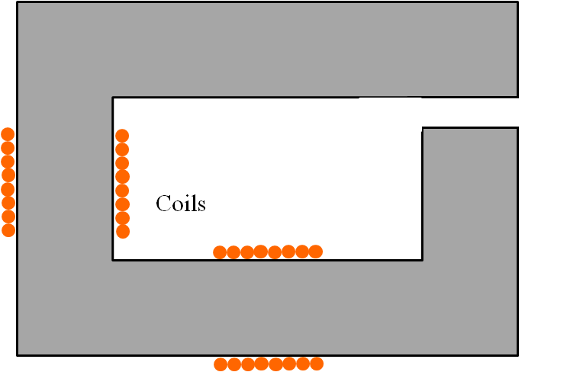
Flux continuity
Let us consider a single loop magnetic circuit without junctions
The normal induction components in the gap and at any interface between different magnetic materials are continuous due to the boundary condition (see below and Lecture 2). Since the flux is the induction normal component multiplied by the cross-section, we obtain that the flux is also continuous at any interface or gap.
The boundary condition for the induction normal components.

Slide 16
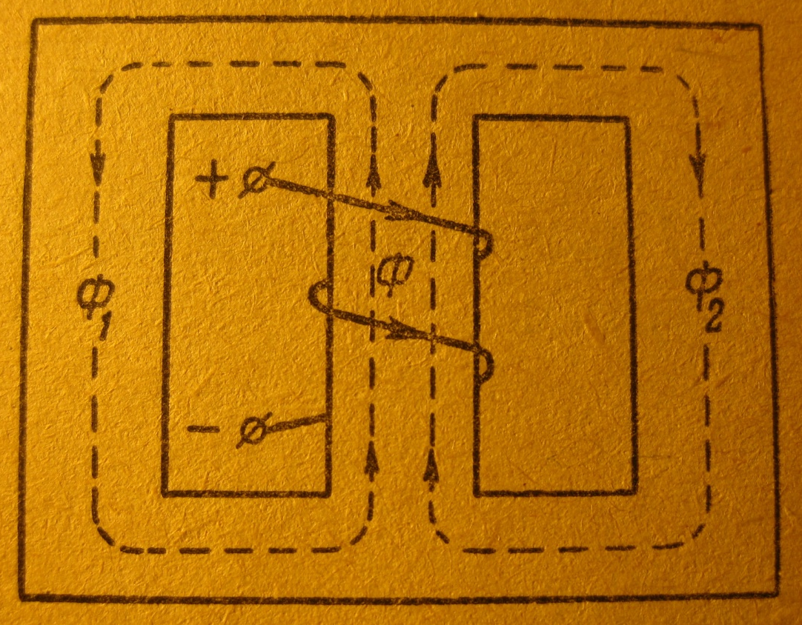
First Kirchhoff’s law for magnetic fluxes
Junction
In a junction
Junction
The algebraic sum of all magnetic fluxes in a junction equals zero. In this sum, a flux is positive if it comes to the junction and negative if it leaves the junction.

Slide 17
Magnetic reluctance
Let us consider a single loop magnetic circuit without junctions.

Slide 18
Magnetic reluctance of a single loop
(A/Wb, Ampere per Weber, SI)
− magnetic reluctance of each part in the loop.

Slide 19
Second Kirchhoff’s law for a magnetic loop
Analogy with electric circuits: magnetic Ohm’s law
Current
×
Resistance
=
Voltage

Slide 20
Magnetic reluctance
The permeability μ of ferromagnetic materials is not constant! It varies with frequency, waveshape of applied signals, temperature, and induction. The double-valued nature of permeability gives rise to the well-known hysteresis curve, which is only approximate, varying from batch to batch of the same material. The elusive nature of permeability is one reason that the study of magnetic devices and circuits appears somewhat esoteric. The analysis of magnetic circuits generally uses constant and single-valued approximations for permeability over a limited range. Selecting these approximations and their boundaries is a major task of magnetic design.
In the majority of magnetic circuits consisting of iron parts and one or more air gaps, the reluctance of the iron parts is very much less than the reluctance of the gaps. At first sight this can seem surprising, since the distance across the gap is so much less than the rest of the path through the iron. The fact that the air gap dominates the reluctance is simply a reflection of how poor air is as a magnetic medium, compared with iron.

Slide 21
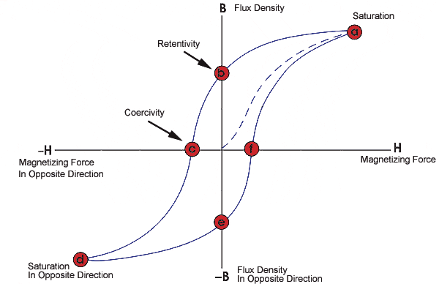
Magnetic saturation
It would be reasonable to ask whether there is any limit to the induction at which the iron can be operated. In the previous slides we have noted that the iron has almost no reluctance, at least not in comparison with air. Unfortunately this property is true as long as the induction remains below about 1.6−1.8 T (Tesla, SI), depending on the particular steel in question. If we try to work the iron at higher induction, where it is saturated (see the hysteresis loop), the permeability becomes very small and the iron core begins to exhibit significant reluctance, and no longer behaves like an ideal conductor of flux. To avoid the undesirable effects of saturation, the cross-section S of the iron parts of the magnetic circuit are usually chosen so that the induction B = Φ/S does not exceed about 1.5 T. For the hysteresis loop shown below, the permeability μ is high and approximately constant in the middle part of the loop, where the blue line (high permeability) and red lines (saturation) are the linear approximations of the BH function. For the blue line, μ = B(H) /μ₀H = const and the iron reluctance is very low.
Iron reluctance
μ = B(H) /(μ₀H) = const
1
Induction, T
2

Slide 22
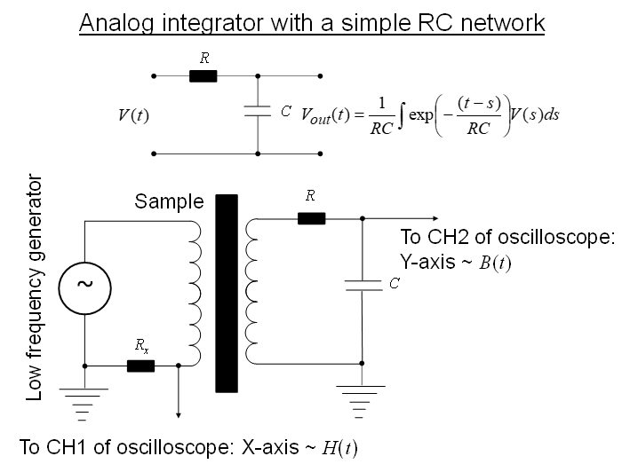

Slide 23
Redistribution of magnetic flux
l
“Common path”
“Left loop”
“Right loop”
l₁
l₂

Slide 24
Redistribution of magnetic flux
The left and right loops, and also the common path can be made of different magnetic materials.

Slide 25
Redistribution of magnetic flux

Slide 26
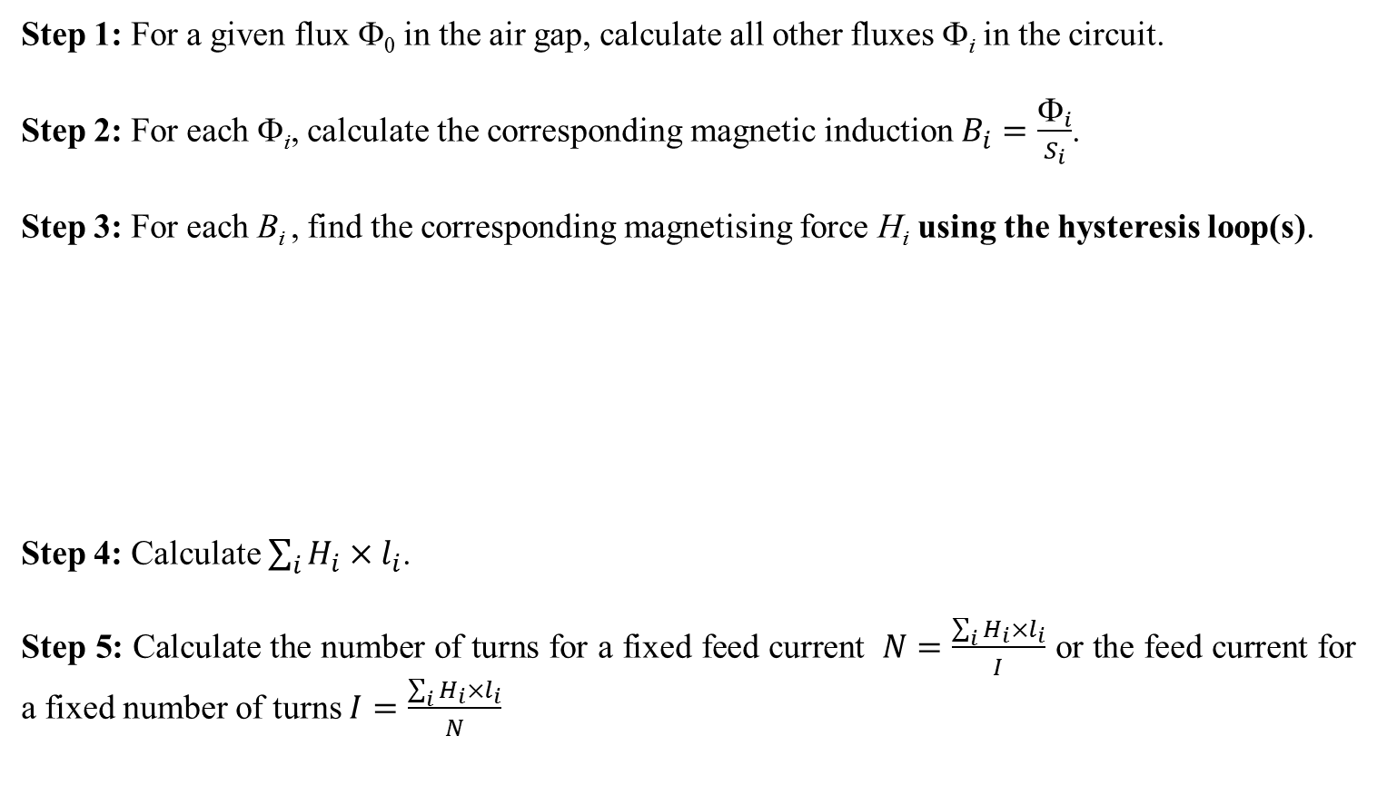
The main steps in designing a magnetic circuit
Typical task: For a given geometry of magnetic circuit and a given magnetic flux in the air gap, we have to find the coil parameters: (i) the number of turns for a fixed feed current or (ii) the feed current for a fixed number of turns.
Step 1: For a given flux Φ₀ in the air gap, calculate all other fluxes Φ_{i} in the circuit.
Step 2: For each Φ_{i}, calculate the corresponding magnetic induction $B_{i}=\frac{Φ_{i}}{S_{i}}$.
Step 3: For each B_{i} , find the corresponding magnetising force H_{i} using the hysteresis loop(s).
Step 4: Calculate $\sum_{i}{H_{i}×l_{i}}$.
Step 5: Calculate the number of turns for a fixed feed current $N=\frac{\sum_{i}{H_{i}×l_{i}}}{I}$ or the feed current for a fixed number of turns $I=\frac{\sum_{i}{H_{i}×l_{i}}}{N}$

Slide 27
Permeability and magnetic circuit design
If the magnetising forces in a soft magnetic circuit do not saturate it, we can use permeabilities and reluctances to calculate all the circuit parameters.

Slide 28
Summary
− the main integral theorem reformulated for magnetic circuits
− magnetomotive force
− magnetic reluctance
− First Kirchhoff’s law for magnetic fluxes in a junction

Slide 29
Flux in a single loop magnetic circuit with a coil
Coil
N – number of turns
I – feed current

Slide 30
Coil permeance P
This proportionality coefficient P between the flux Φ through the coil and the feed current I is called the permeance.
The relation Φ = P×I remains true for any single or multiple loop magnetic circuit if Φ is the magnetic flux through a particular coil with the feed current I. Then, P will be the permeance of this coil.
Note that all parts of a magnetic circuit affect the coil permeance, not only the part inside the coil.

Slide 31
Self-induction effect in a coil
Coil
N – number of turns
I – feed current
The additional e.m.f. V(t) induced in the coil by the flux Φ (Faraday’s law).
− self-induction effect

Slide 32
Coil self-inductance L
The additional e.m.f. V(t) induced in the coil
This proportionality coefficient L (H, Henry, SI) is called the self-inductance. Note that all parts of a magnetic circuit affect the coil self-inductance, not only the part inside the coil.

Slide 33
Variable permeance P(t) and self-inductance L(t)
Along with an alternating feed current I(t), some parts in the magnetic circuit may move: the rotation θ(t) or the linear displacement x(t):
The additional e.m.f. V(t) induced in the coil.

Slide 34
Variable permeance P(t) and self-inductance L(t)
To simplify the analysis, we should separate the circuit internal properties from the dynamic equation for θ(t) or x(t). To do this, when calculating the derivative ∂L(t)/∂t we have to replace the partial time derivative ∂/∂t with the total time derivative d/dt:
The additional e.m.f. V(t) induced in the coil

Slide 35
Two inductively connected coils (transformer) and
mutual induction effect
Mutual induction effect, where V₁(t) and V₂(t) are the electromotive forces induced in the coils.

Slide 36
Mutual inductances M₁₂ and M₂₁

Slide 37
Mutual inductances M₁₂ and M₂₁
This relation is true only for the ideal magnetic circuits without leakage.
General relation

Slide 38
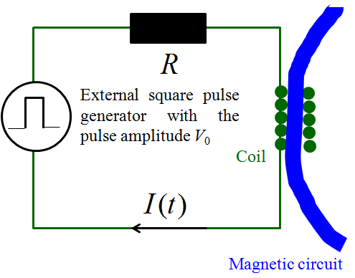
Experimental determination of the coil self-inductance
The self-inductance L of a coil can be found by measuring the characteristic time τ of the current transition process in the electric circuit with the square pulse voltage excitation, shown below. All other coils must be disconnected (zero current). In formulas, R is the total circuit resistance!
To oscilloscope V_{Rx}(t) = I(t)×R_{x}
YT-mode
R_{x} – signal resistor

Slide 39
Summary
− coil permeance which can depend on the time
− magnetic flux
− coil self-inductance which can depend on the time
− e.m.f. V(t) induced in the coil by the feed current I(t) (self-induction effect) if L = const

